Slide 1
Historical Methods Analysing texts and material artifacts
Ms Farhana Afroz
Lecturer | Department of Social Science | AIUB

Slide 2
What is history?
History (from Greek ἱστορία - historia, meaning "inquiry, knowledge acquired by investigation”
The study of past events, particularly in human affairs.
“Just the facts, Ma’am. Just the facts”????? (Historians are interested only in compiling list of names, dates, places, and “important” events that happened sometime in the past. But history is much more than this)????
History is more than merely a series of easily memorized dates and facts. – Tuchman (1998)
“A special form of thought” – Collingwood (1973)

Slide 3
There are no facts, only interpretations. --Friedrich Nietzsche
মনুষ্য চিত্রকর বলিয়াই চিত্রে সিংহ পরাজিতস্বরূপ লিখিত হয়। –ভারত-কলঙ্ক, বিবিধ প্রবন্ধ, বঙ্কিম রচনাবলী।
চিত্রে লেখা আছে, মনুষ্য সিংহকে জুতা মারিতেছে। চিত্রকর মনুষ্য এক সিংহকে ডাকিয়া সেই চিত্র দেখাইল। সিংহ বলিল, সিংহেরা যদি চিত্র করিতে জানিত, তাহা হইলে চিত্র ভিন্নপ্রকার হইত। –বাঙ্গালার ইতিহাস সম্বন্ধে কয়েকটি কথা, বঙ্গদর্শন, ১২৮৭, অগ্রহায়ণ (১৮৮০?); বঙ্কিম রচনাবলী।

Slide 4
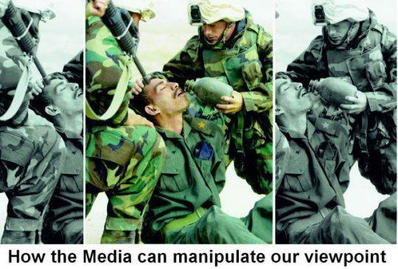
Representation

Slide 5

Is the glass half empty or half full?

Slide 6
The debate on 'narrative' or 'linguistic turn‘ has been a significant issue within the profession for several years.
the narrative construction = organizing facts? the historical narrative must always be transparent in referring to what actually happened according to the evidence.
the linguistic turn - the essential element in the postmodern challenge to a view of history founded solely on the empirical-analytical model

Slide 7
The nineteenth century European critique, particularly in the work of Hegel and Nietzsche, moved beyond how knowledge is derived, to concentrate more how it is represented, and the effects the process of representation has upon the status and nature of our knowledge.
Since the 1960s, for example, the discipline of history has experienced a 'social science turn', a 'cliometric' or 'statistics turn', a 'women's history turn', a 'cultural history turn' and so on.

Slide 8
Historical questions Who? what? when? where? why?
In general, we may want to use historical methods to understand “big picture” types of questions.
E.g. How did major social changes take place?
When? Why are social arrangements different in various places and times?
How the women’s movement emerged in various times and places, And the like.

Slide 9
Working with sources Identifying historical sources
Primary sources: Physical traces/ Material artifacts/ public records/ documents and public papers/
Secondary sources: Primary sources are the “raw’ materials of history” while secondary sources are the “’cooked’ analyses of those materials”

Slide 10
Primary sources:
A primary source is an original object or document; first-hand information.
Primary source is material written or produced in the time period that you may be investigating.
Primary sources enable the researcher to get as close as possible to what actually happened during an historical event or time period.

Slide 11
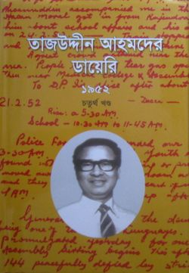
Primary sources
Diaries and journals
Example: Tajuddin Ahmed was a young political activist in 1952. He kept a diary or journal of the political events of that year. His diary was later published. This is a primary source with regard to our language movement as he wrote it at the time it happened.

Slide 12
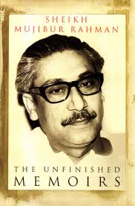
Primary source:
Autobiographies
An autobiography is when you write a story or book about yourself.
Example: The Unfinished Memoirs of Sheikh Mujibur Rahman is a primary document because he wrote his first hand experiences.

Slide 13
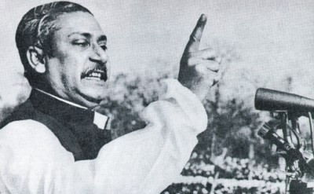
Primary source
Speeches are considered Primary Sources.
Examples of Speeches:
7th March speeche of Bangabandhu
Martin Luther King’s “I Have a Dream”
All of the President’s Inauguration Speeches.

Slide 14
Primary source
Historical documents such as the Declaration of Independence or the Constitution are primary documents. They were drafted and signed.
Other Primary Sources would be : Birth Certificates/ Government records/ Deeds/ Court documents / Military records / Tax records / Census records/ Art

Slide 15
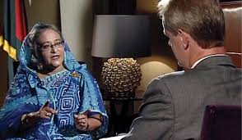
Primary source
Sound Recordings and interviews are considered primary resources.
Example: Sheikh Hasina in HardTalk

Slide 16
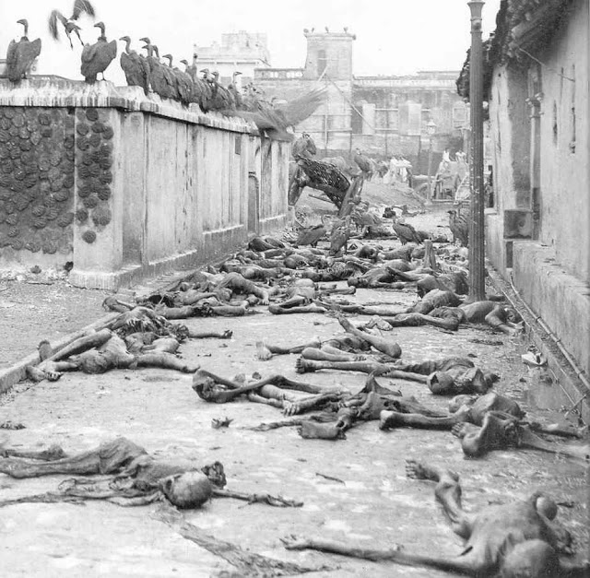
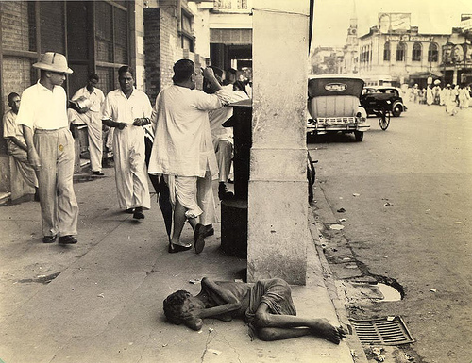
Primary source
Photographs and videos are primary sources.

Slide 17
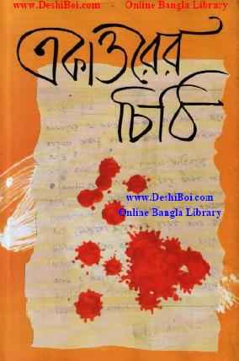
Primary source
Letters are considered primary documents.
Example: Soldiers during wars wrote to their families about war events they experienced. Those letters are considered primary sources.

Slide 18
What is a secondary source?
A secondary source is something written about a primary source.
Secondary sources are written "after the fact" - that is, at a later date.
Usually the author of a secondary source will have studied the primary sources of an historical period or event and will then interpret the "evidence" found in these sources.
You can think of secondary sources as second-hand information.

Slide 19
Secondary source
Primary sources are the “raw’ materials of history” while secondary sources are the “’cooked’ analyses of those materials”
For example: Biography
A biography is when you write about another person’s life. Louis Fischer wrote a biography on the life of Mahatma Gandhi (The Life of Mahatma Gandhi). This is a secondary document. It was written about him after he died.

Slide 20
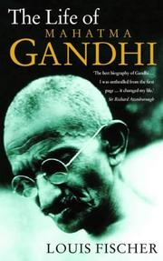
Example of a secondary source

Slide 21
Historical sources:
primary or secondary? Newspaper: primary or secondary??? Media accounts....
Electronic texts: official website/Blog/ youtube/facebook/wikipedia

Slide 22
Evaluating sources
Historians are bit like detectives. We use evidence to find out what happened and why? We are like judge, aren’t we????
Historians need to be “systematic, dispassionate and evidence-based”
Recognize evidence = decide its usefulness = findings

Slide 23
Four criteria in approaching and utilizing a document (Scott, 1990)
Authenticity: to identify whether a document is genuine, look for factors such as internal consistency of presentation and style, soundness of the origins of the document and recognized authorship.
Credibility: to identify whether the document is accurate, and is a reliable relaying of events.

Slide 24
Continued
Representativeness: to find whether the document is typical of its genre or, if it is ‘untypical’, to understand how a particular interpretation of an event sits among or excludes others.
Meaning: this refers to the document’s clarity and comprehensibility, and what its meaning is in the social and political context within which it was produced.

Slide 25
Authenticity: recognizing authorship
Primary sources: was it actually written by the person said to have written it? When was it written? Where? Is the document authentic, or merely a clever fake?
We need to ask whose perspective they reflect and what kinds of interest the writer had?
Do you have access to the whole document, or only fragment? What didn’t survive? Did anyone have interest in supporting certain parts of the material?

Slide 26
Evaluating secondary sources
When was the sources published? does the author provide sufficient and logical support for his/her thesis? How does the source compare with others I have consulted?
Who is the author? Why did he/she write it? Who was the intended audience? Are there detectable biases in the source? What is the historical context in which the source was written and read? Are there other contemporary sources to compare against this one?

Slide 27
Creating meaning of sources
When evaluating historical documents we need to understand in both a literal (or surface) level and a deeper one.
Surface: what document was means and what language was used? i.e. Words from one period to the next...
Deeper level: conditions under which the document was produced? Need knowledge of the specific context and time period.

Slide 28
Historical and documentary research demands:
Knowledge of the particular, local contexts in which various materials are produced, consumed, kept, and discarded.
A critical eye and ability to scrutinize sources carefully.

Slide 29
Is there any historical research in Bangladesh?
Are we ready to be a reader of objective History?

Slide 30
Thank you!

